Slide 1
Presentation on Game Development
Submitted to-
Mr. Mohammad Marufur Rahman
Lecturer, Ahsanullah University of Science and Technology
Mr. Nibir Chandra Mandal
Lecturer, Ahsanullah University of Science and Technology
Presented by-
Team: ONE_BY_ZERO
Members: Zarin Tasnim Roichi
&
Habiba Binty Khorshed

Slide 3
What is Maze Mender?
Puzzle-making game that uses different shapes like L, Z, O, and square.
Shapes are made of four squares each.
This game is inspired by the game ‘Tetris’

Slide 4
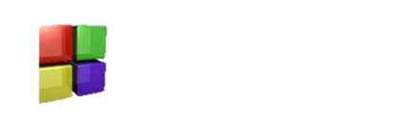

What will be used for creating this game?
Visual Studios 13[This game is created using <graphics.h> header file and compiled and executed in turbo C++]
Code Blocks

Slide 5
Game Rules
The types of shapes I want to develop for our version of the game are geometrically visual.
The falling puzzle pieces must consist of four squares each.
There is a certain time for the falling pieces.
The shapes move on a square-by-square basis
The game is considered to be over if pieces reach the top of the screen.
You have to remove pieces from that screen by filling all the blank spaces in a line.

Slide 6
Thank you!
“Any question?”

